Slide 1
Project: On-demand Traffic light control
Embedded system professional track-egfwd
By: shaimaa farag okily

Slide 2
System introduction(description)
Traffic lights are signaling devices positioned at road intersections, pedestrian crossings, and other locations to control the flow of traffic.
Traffic lights normally consist of three signals, transmitting meaning to drivers and riders through colors and symbols including arrows and bicycles.
The regular traffic light colors are red, yellow, and green arranged vertically or horizontally in that order.
Although this is internationally standardized, variations exist on national and local scales as to traffic light sequences and laws.
You are required to implement a traffic lights system with an on-demand crosswalk button.
Crosswalk buttons let the signal operations know that someone is planning to cross the street, so the light adjusts, giving the pedestrian enough time to get across.

Slide 3
System design
1-Hardware requirements:
ATmega32 microcontroller
One push button connected to INT0 pin for pedestrian
Three LEDs for cars - Green, Yellow, and Red, connected on port A, pins 0, 1, and 2
Three LEDs for pedestrians - Green, Yellow, and Red, connected on port B, pins 0, 1, and 2
2-Software requirements: In normal mode:
Cars' LEDs will be changed every five seconds starting from Green then yellow then red then yellow then Green.
The Yellow LED will blink for five seconds before moving to Green or Red LEDs.
In pedestrian mode:
Change from normal mode to pedestrian mode when the pedestrian button is pressed.
If pressed when the cars' Red LED is on, the pedestrian's Green LED and the cars' Red LEDs will be on for five seconds, this means that pedestrians can cross the street while the pedestrian's Green LED is on.
If pressed when the cars' Green LED is on or the cars' Yellow LED is blinking, the pedestrian Red LED will be on then both Yellow LEDs start to blink for five seconds, then the cars' Red LED and pedestrian Green LEDs are on for five seconds, this means that pedestrian must wait until the Green LED is on.
At the end of the two states, the cars' Red LED will be off and both Yellow LEDs start blinking for 5 seconds and the pedestrian's Green LED is still on.
After the five seconds the pedestrian Green LED will be off and both the pedestrian Red LED and the cars' Green LED will be on.
Traffic lights signals are going to the normal mode again.

Slide 4
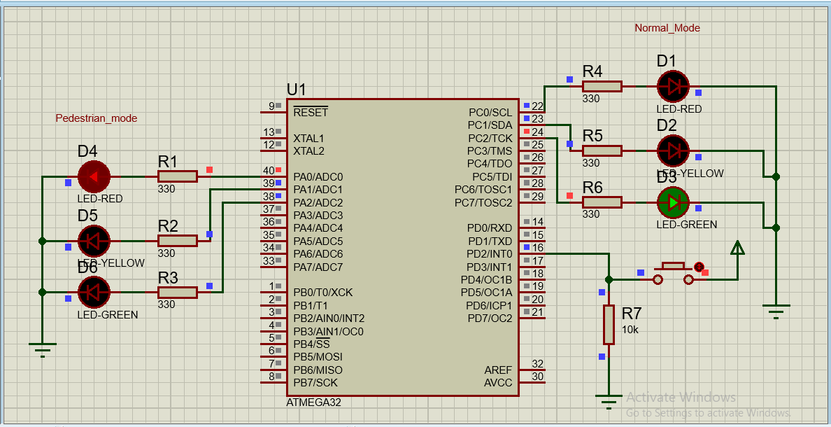

Slide 5
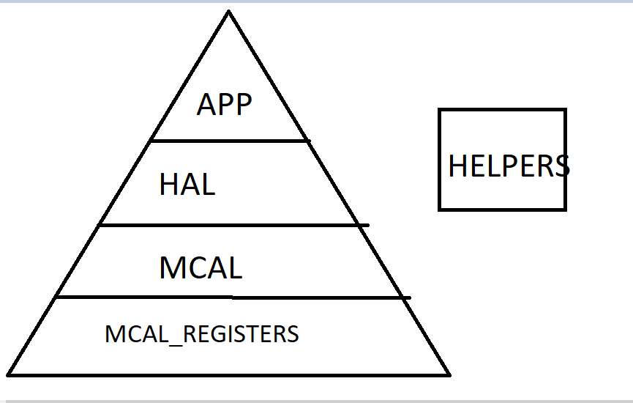
Microcontroller layered architecture

Slide 6
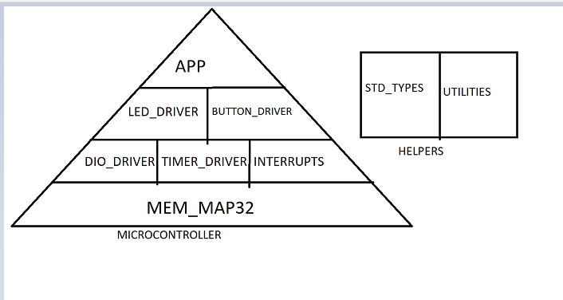
Microcontroller drivers

Slide 7
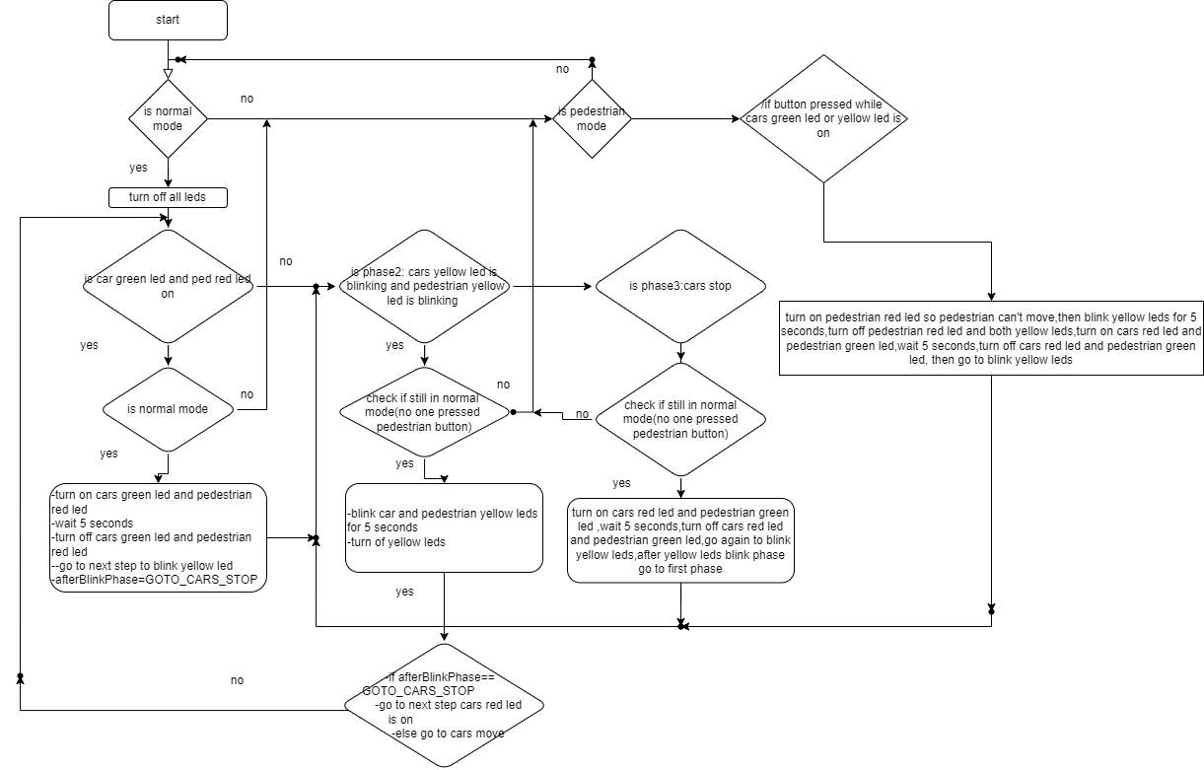
System flow chart

Slide 8
System constraints
As a pedestrian when I made a long press on the crosswalk button, I expect nothing to be done, except the first press will affect as we use rising edge interrupt, and if we turned to falling edge interrupt there will be no effect till the end of the press.
As a pedestrian when I made a double press on the crosswalk button, I expect that the first press will do the action and nothing to be done after the second press.

